Slide 1
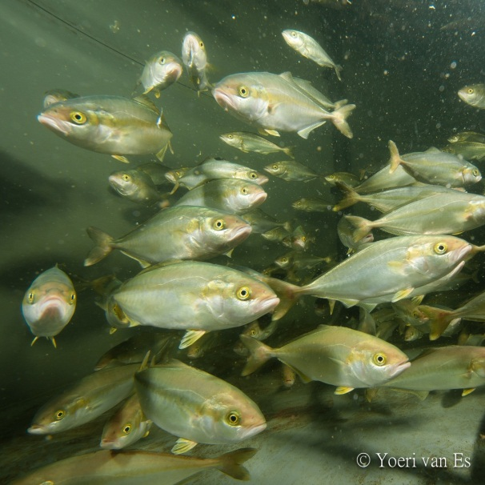


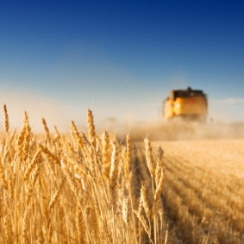
Developing Yellow Tail Kingfish Farming in Land-Based Closed-Containment Systems
Kees Kloet, Silt bv
Andries Kamstra, Wageningen-Imares
Aquacultuur symposium St-Niklaas, november 2013

Slide 2
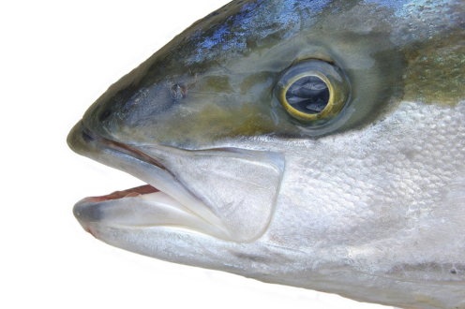
Content
Global status of Seriola farming
Rationale for YTK in RAS
Development of the project, Lab>Pilot>Commercial
System lay-out
Design parameters, water quality
Projected cost structure; competitive power
Marketing & Sales
Research & Prospects

Slide 3
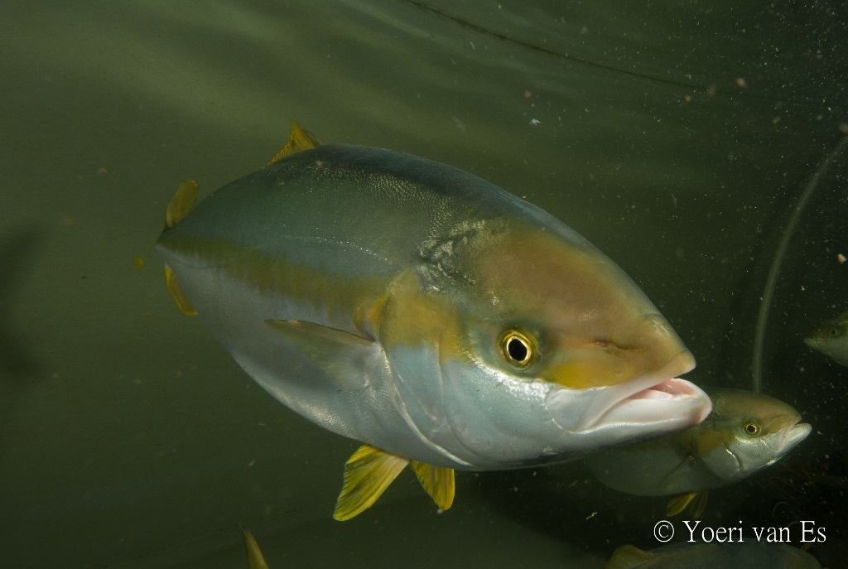
yellowtail kingfish, Seriola lalandi

Slide 4
Global status of Seriola farming
9 species, 4 in aquaculture
130.000 tonnes production
80% Jap. amberjack
6 sites reproduction S. lalandi
Fish Base

Slide 5
Rationale for YTK in RAS
Demand fresh product sushi/sashimi/carpaccio
Demand local product, certified and sustainable
Alternative for Tuna
Technology RAS developed
Fingerling production developed

Slide 6
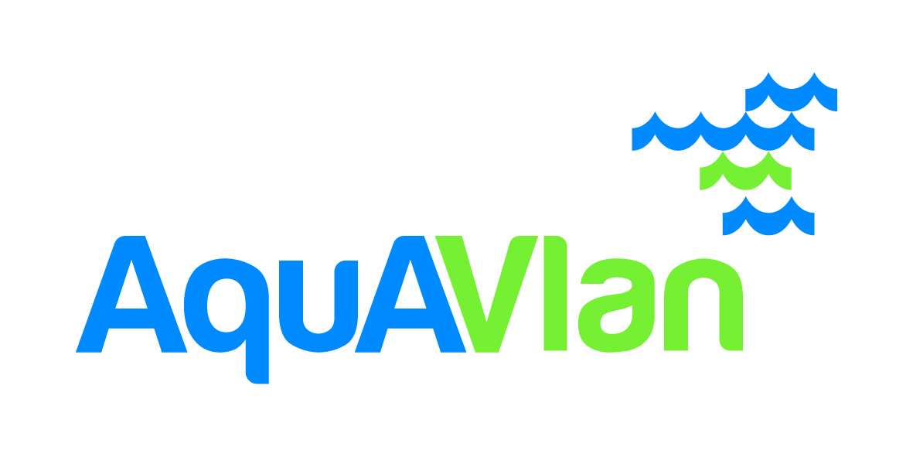

Development of the project
Start: project Fork to Farm 2009: lab-scale IMARES
  Water quality criteria
  Performance data
Pilot scale at farm with fish from IMARES
Start Silt 2011

Slide 7
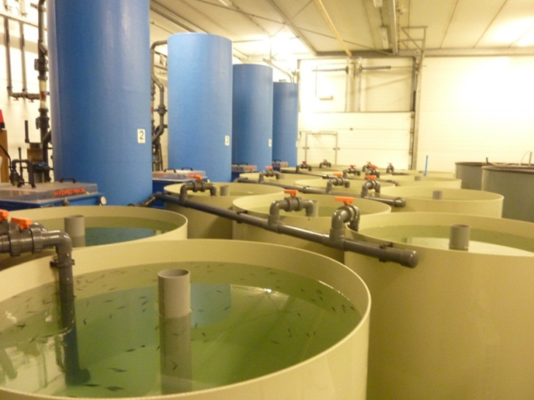
Lab-scale trials YTK
Replicated RAS
Very fast growth rate
growth
FCR: 0.7
FCR: 1.0

Slide 8
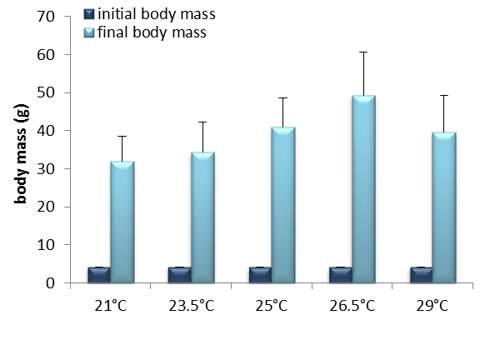

Temperature
c
b
b
a
a
FCR: 1.13 1.11 0.98 0.88 1.00
Abbink et al.(2011). Aquaculture 330-33: p 130-135.

Slide 9
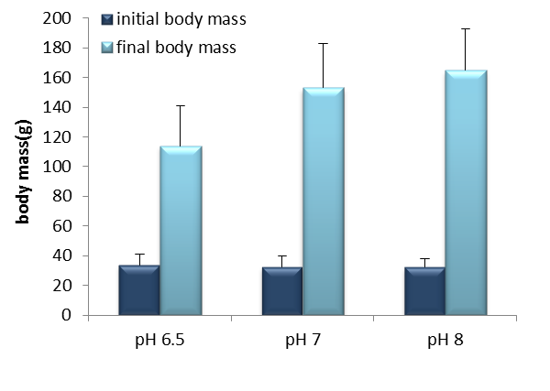
pH
b
b
a
35
FCR: 1.26 0.98 0.91
Abbink et al.(2011). Aquaculture 330-33: p 130-135.

Slide 10
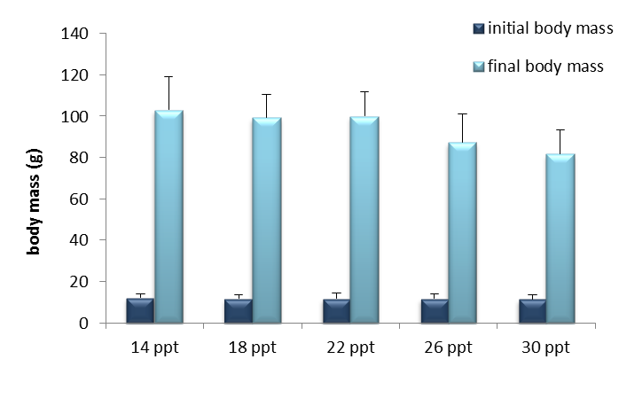
Salinity
a
a
a
b
b
12
FCR: 0.77 0.76 0.77 0.81 0.82

Slide 11
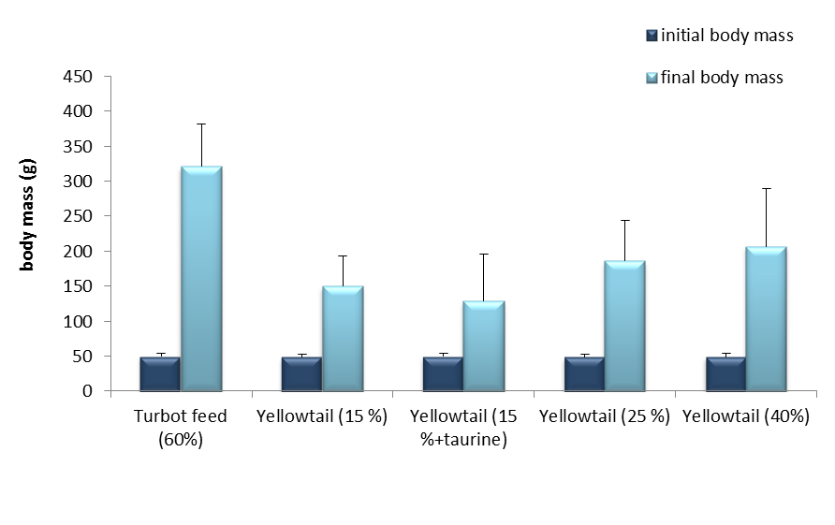
Feed

Slide 12
Flow scheme Silt bv
136 m³ Tricklingfilter
Bionet 200
14 x 27 m³
Drums, 40 micron
to tanks
900 m³/h
Skimmer
70 m³/h
O₂
Upflow filters
40 m³
80 m³/h
USB 30 m³
120 m³/d
O₃
To sludge storage

Slide 13
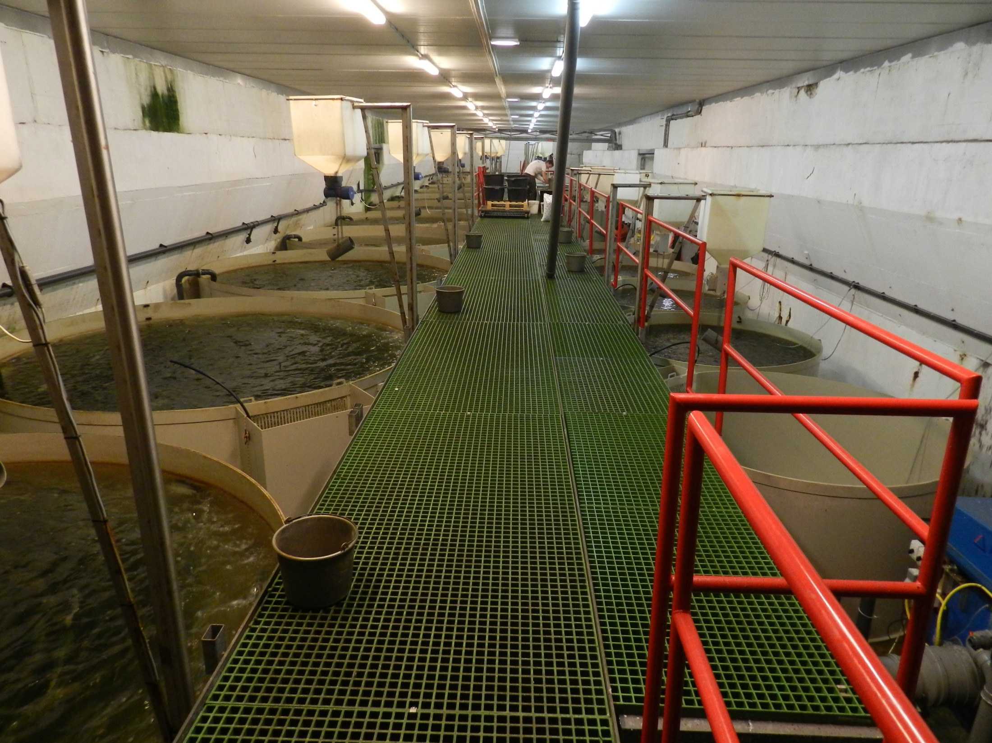

Slide 14
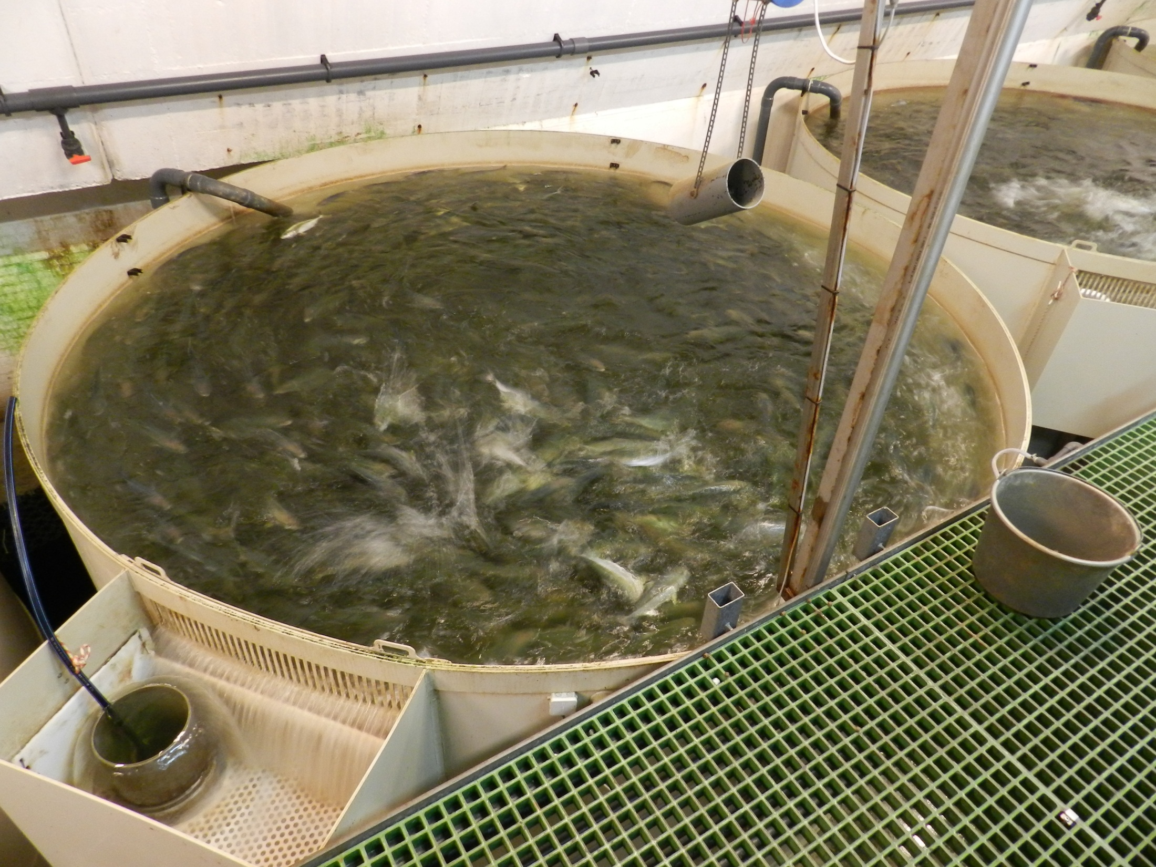

Slide 15
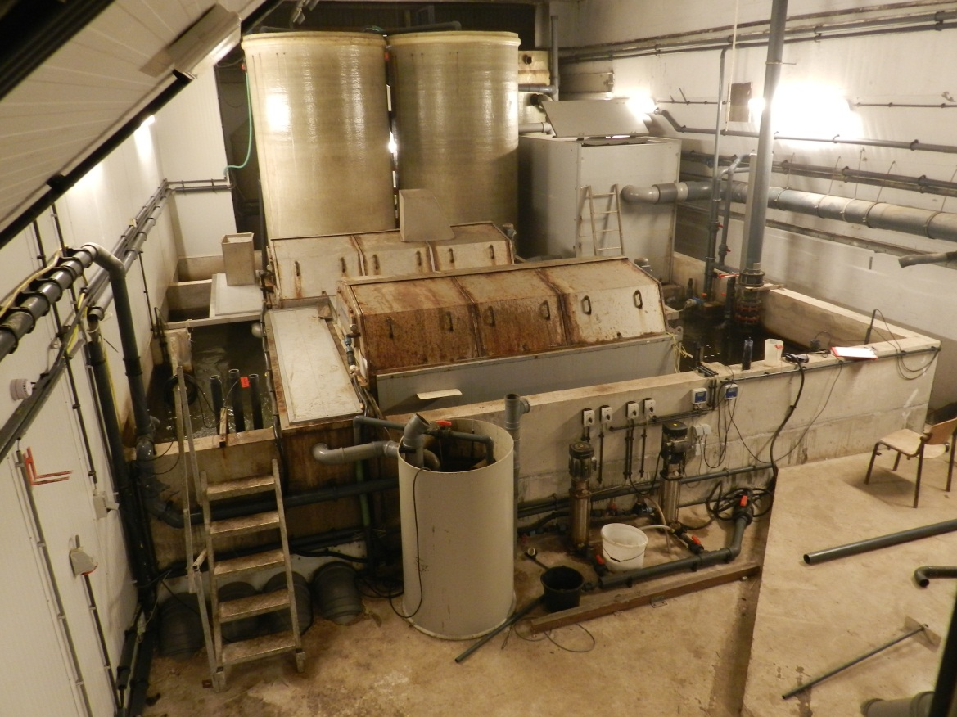
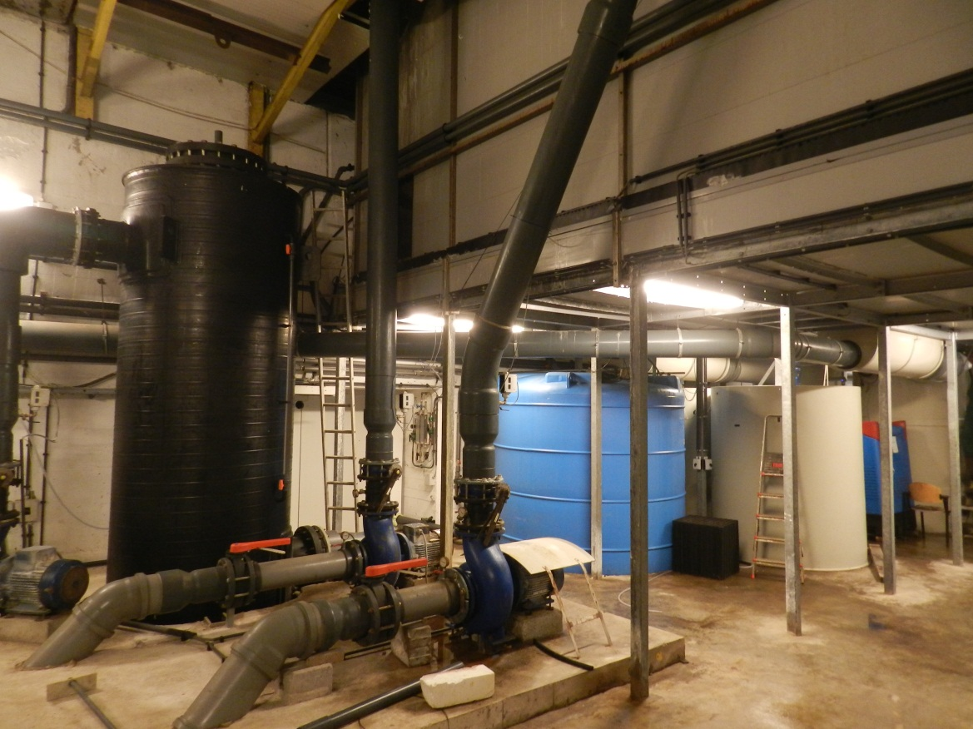

Slide 16
System performance
Design capacity 100 T/y
Max feed load realised: 450 kg/d = OK
Water use: 1000 l/kg feed (borehole 25 ppt)
Temperature: 21-24
TAN: 1.3 ± 0.8
NO₂-N: 0.4 ± 0.2
NO₃-N: 55.3 ± 11.1
pH>7.2
CO₂ < 10 mg/l

Slide 17
Economy: key numbers
100 T/Y, not reached
Desk study Aquavlan
1-2500 grams in 1 year
250 kg/m³/y
FCR 1.6
Investment 6,70 €/kg production
IRR 22%

Slide 18
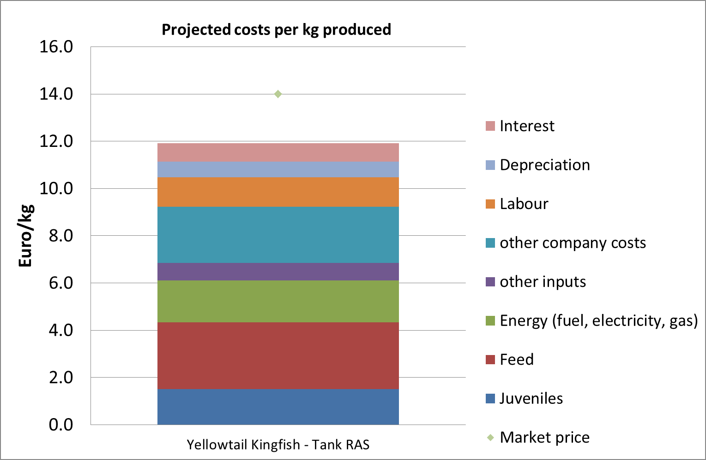
Projected cost structure

Slide 19
Competitive power RAS vs Cages
RAS more expensive
RAS better certifiable
RAS for ‘local’ production
¥ vs €/$

Slide 20
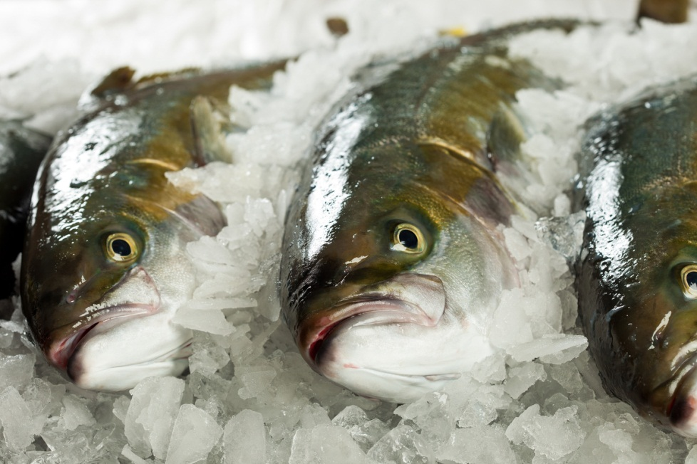
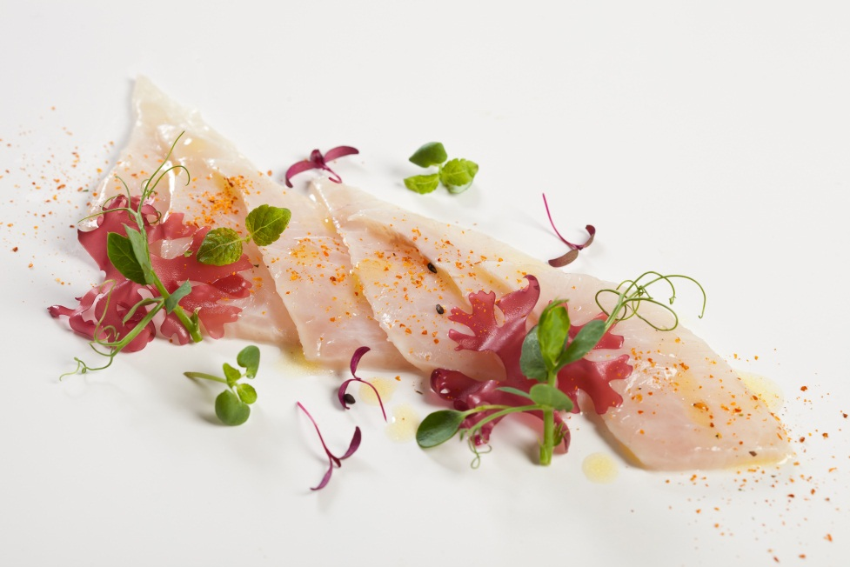
Marketing & Sales
Well received product
Applications: sushi/sashimi
Western-Europe, fresh round

Slide 21
Depuration!
Marine RAS have off-flavour
  Turbot
  Kingfish
For YTK 2 days in make-up water
Awareness with all producers!

Slide 22

Research & Prospects
Reproduction/breeding
On-growing diets
  Quality
  Reduction fish meal
Welfare,
  slaughter methods,
  water quality

Slide 23
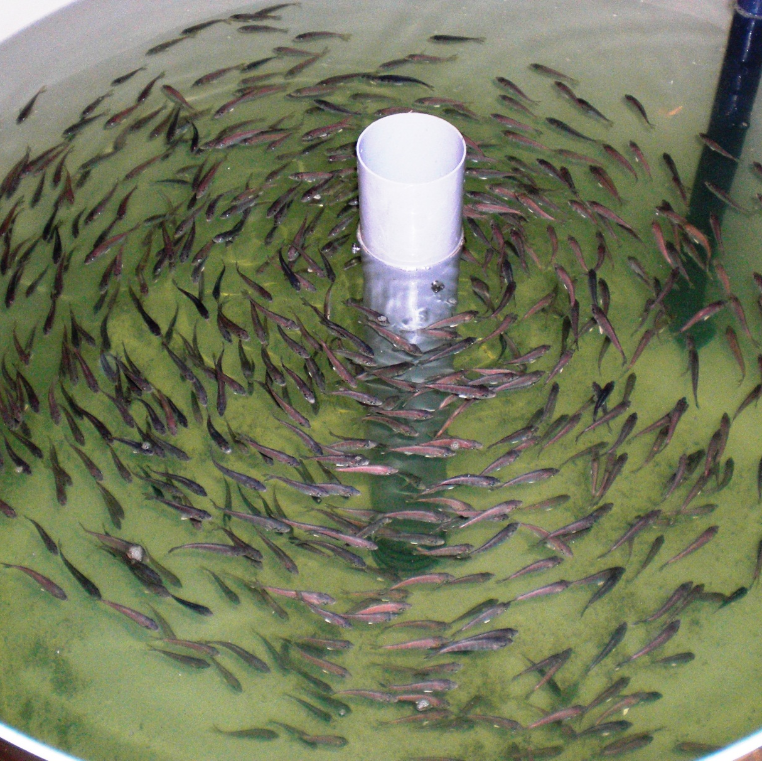
Thank you for your attention.
Questions?

